Slide 1
Exchange Arrangements Entering the 21st Century:
Which Anchor Will Hold?
Ethan Ilzetzki, London School of Economics
Carmen M. Reinhart, Harvard University
Kenneth S. Rogoff, Harvard University

Slide 2
Overview
New classification methodology of anchor currencies and exchange rate arrangements
USD most dominant anchor by far
World has not moved to greater exchange rate flexibility
  Bretton Woods II, as in Dooley et al (2003)
Anchor currency classifications shed further light on new Triffin Dilemma
  Farhi, Gourinchas & Rey (2011), Obstfeld (2013), Farhi & Maggiori (2016).

Slide 3
The Changing Landscape

Slide 4
Existing Classifications
Exchange Arrangements:
  Reinhart and Rogoff (2004)
  Shambaugh (2004)
  Levi-Yeyati and Sturtzenegger (2005)
  IMF (annually)
Anchor Currencies:
  Frankel and Wei (1994) for E. Asia
The first to integrate anchor classification formally with ERA classification.

Slide 5
Why a New Methodology?
Introduction of Euro
  How to think of supranational currency?
  New major candidate anchor
Proliferation of Inflation targeting in EMs
  Increased exchange rate volatility…
  …despite extensive exchange market intervention
Decreased volatility in G7 economies

Slide 6
Declining Exchange Rate Volatility
Note: Four year moving average of the absolute value of the change in the dollar-Deutschemark bilateral exchange rate. (dollar-Euro from Jan 1999). Trend for dollar-yen is similar.

Slide 7
Methodology

Slide 8
Exchange Rate Classifications
Two classifications: coarse and fine

Slide 9
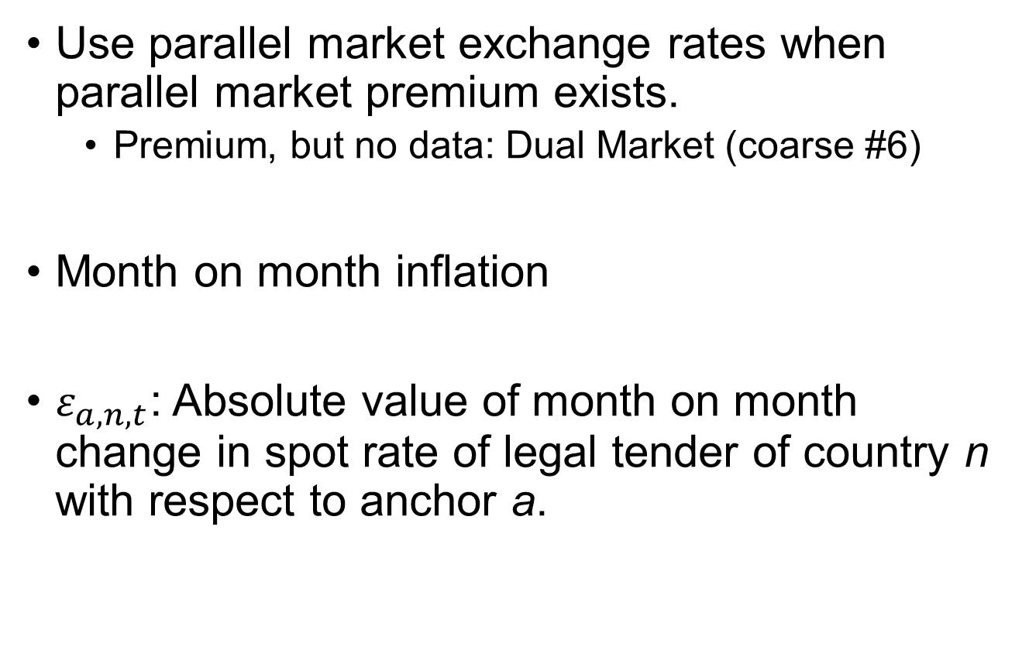
Data
Use parallel market exchange rates when parallel market premium exists.
  Premium, but no data: Dual Market (coarse #6)
Month on month inflation
$ε_{a,n,t}$: Absolute value of month on month change in spot rate of legal tender of country n with respect to anchor a.

Slide 10
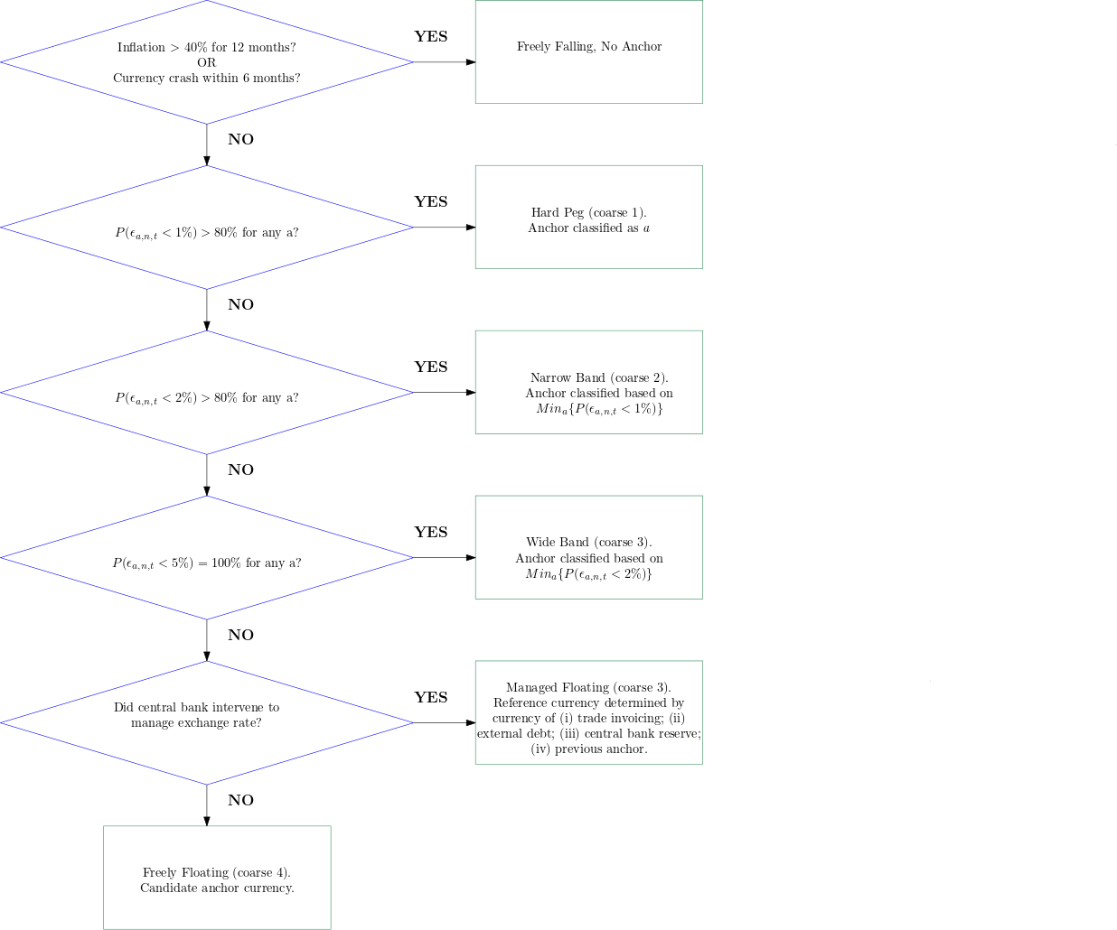
Classification Algorithm in a Nutshell

Slide 11
Candidate Anchors
USD
EUR (DEM, FFR)
JPY
GBP
ZAR
CHF
RUB
AUD
BRL
CAD and TRL when they are freely floating
USD-EUR, USD-JPY, USD-EUR-JPY equally weighted baskets and pre-announced de-jure baskets.
RMB not candidate anchor—itself anchored to USD
  Possible latent anchoring to RMB.

Slide 12
Managed vs. Freely Floating
Historical analysis of exchange rate intervention in Appendix 1.
Classify as managed floating if central bank frequently intervened with explicit aim of managing exchange rate’s level, path, or variability.
Sources:
Central bank minutes, reports, and statements; the IMF’s Annual Report on Exchange Arrangements and Exchange Restrictions; OECD and BIS reports; the US Treasury’s biannual Report to Congress on International Economic Exchange Rate Policies; central bank data on reserve holdings and net FX purchases; press reports; and country-specific research.

Slide 13
Floating in the 21st Century
14 currencies were floating at some point in 21st century.
Floating exchange rate practices in the 21st century fall in to 3 broad categories:
Australia, Canada, Japan (?), SAF, UK, US never intervened: freely floating.
Brazil and Turkey experimented with freely floating 2000-10, but resumed intervention (managed floating) during the crisis.
All other cases intervened regularly: Managed floating.

Slide 14
Reference Currency Classification

Slide 15
Exchange Arrangements in the 21st Century

Slide 16
Post World War II Major Anchor Currencies
Note: Share of countries weighted by their share in world GDP, 1950-2015, excluding freely falling cases.
Link to dynamic map.

Slide 17
Post World War II Major Anchor Currencies
Note: Share of countries 1946-2015, excluding freely falling cases.

Slide 18
Drivers of Anchor Currencies
Natural monopoly of global currency in goods and financial markets.
Trade: Swoboda (1969), Bacchetta and Wincoop (2005), Goldberg and Tille (2008).
Bond Markets: He, Krishnamurthy and Milbradt (2016), Hassan, Mertens, and Zhang (2016).
Trade + Bond Markets: Gopinath and Stein (2018).
Political Economy: Rogoff (2001).

Slide 19
Markers of an Anchor Currency

Slide 20
Markers of an Anchor Currency (cont.)

Slide 21
Anchor Currencies: Summary
The dollar is the dominant anchor currency by far
  70% of world GDP is anchored to the dollar
  Euro is a far second at 15%
The share of countries anchored to the dollar is nearly double the share at the peak of Bretton Woods.
Dollar dominance shows up in all markers of an anchor currency
By some metrics, the role of the euro has stalled
  Decline of Eurozone as a share of world GDP
  Loss of some key satellites, e.g. UK

Slide 22
De Facto Exchange Rate Arrangements
Coarse Classification, Share of Countries
Group 2: Gradualist adjustment (from crawling peg to narrow crawling bands)
Note: Share of countries, 1946-2015, Groups 1 and 2.
Link to dynamic map.

Slide 23
De Facto Exchange Rate Arrangements
Coarse Classification, Share of Countries
Group 3: Broad bands and
managed floating
Group 4: Freely floating
Note: Share of countries, 1946-2015, Groups 3 and 4.
Link to dynamic map.

Slide 24
De Facto Exchange Rate Arrangements
Coarse Classification, Share of Countries
Group 5: Freeely falling,
inflation > 40%
or currency crash
Group 6: Multiple, dual, or
parallel markets with limited or
no data on the structure of
exchange rates
Note: Share of countries, 1946-2015, Groups 5 and 6.
Link to dynamic map.

Slide 25
De Facto Exchange Rate Arrangements
Coarse Classification, Share of World GDP
Freely Falling
Freely Floating
Freely Floating
Crawling Peg
Fixed
Note: Share of world GDP, 1950-2015.
Link to dynamic map.

Slide 26
Exchange Arrangements: Summary
Less flexible exchange rate arrangements still the most common exchange arrangement
  Pegs, narrow bands, and crawls: coarse classification 1 and 2
  Nearly the same share of countries as during Bretton Woods
Some movement from hard pegs to slightly more flexible arrangements in coarse classification 2
Freely floating still a rarity.
Far fewer cases of “freely falling” in the current low inflation environment
  With a recent uptick.

Slide 27
Exchange Restrictions Index
New monthly index of exchange restrictions 1946-2016
  Longer time series than prior capital controls indexes
Market based measure, directly related to exchange rate practices.
Index = 1 if (any of the below)
  There is a de jure dual market
  There is a de jure system of multiple exchange rates
  There is an informal parallel market and parallel market premium > 10%.
This is a sufficient condition for capital controls.
  Multiple rates/markets can’t be maintained without limits on capital mobility.

Slide 28
Share of Countries with Exchange Restrictions
Advanced Economies

Slide 29
Share of Countries with Exchange Restrictions
All Countries

Slide 30
The Modern Triffin Dilemma

Slide 31
The Impossible Trinity
Impossible Trinity: Cannot simultaneously achieve exchange rate stabilization, free capital flows, monetary autonomy.
Central banks may have been accumulated reserves in attempt to circumvent this “trilemma”.
  Accumulated at unprecedented rates in 21st century.
Complements existing explanations, e.g. precautionary savings, safe assets
  e.g. Caballero, Farhi, Gourinchas (2017)

Slide 32
The return of exchange rate stabilization has coincided with increased capital mobility

Slide 33
Reserves and Exchange Rate Management

Slide 34
Are Reserves a Substitute for Capital Controls?

Slide 35
The Modern Triffin Dilemma
Triffin (1960): Demand for dollars will outstrip US gold reserves
  End of Bretton Woods 1973
Modern Triffin dilemma: Demand for US dollar assets will outstrip US fiscal capacity.
  Farhi, Gourinchas, Rey (2011); Obstfeld (2013); Farhi and Maggiori (2018).
  ➔End of Bretton Woods II?
Alternatives
  Eurozone has similar limited fiscal capacity, instability
  RMB?
  Multipolar system/SDR
    Eichengreen (2011); Farhi, Gourinchas and Rey (2011).

Slide 36
Role of the Dollar and US Economy 1950-2015

Slide 37
Role of the Franc & DM 1950-1998 and Euro 1999-2015

Slide 38
Role of the Pound and the UK Economy 1950-2015

Slide 39
Role of the Yen and the Japanese Economy 1950-2015

Slide 40
Chinese Economy 1950-2015
China GDP as a share of world GDP
(percent, right scale)

