Slide 1
Why is the Euro Punching Below its Weight?
Ethan Ilzetzki, London School of Economics
Carmen M. Reinhart, Harvard University
Kenneth S. Rogoff, Harvard University

Slide 2
Overview
The euro is the world’s second most important international currency…
But is a far second to the dollar by a broad variety of measures
We document this fact and its plausible causes
  Most prominently: scare supply of safe euro-denominated assets and fragmented capital markets.
We document the ECB’s policies until 2012 as an additional factor.
  “Bundesbank plus” period: continuation of the EERM.
  “Whatever it takes period”: expansion of credit facilities.

Slide 3
The International Role of the Euro

Slide 4
Dollar and Euro as Anchor Currencies
Note: Share of countries anchored to the dollar and euro by their share in world GDP, 1975-2015

Slide 5
Dollar and Euro as Anchor Currencies
Note: Share of countries anchored to the dollar and euro, 1975-2015

Slide 6
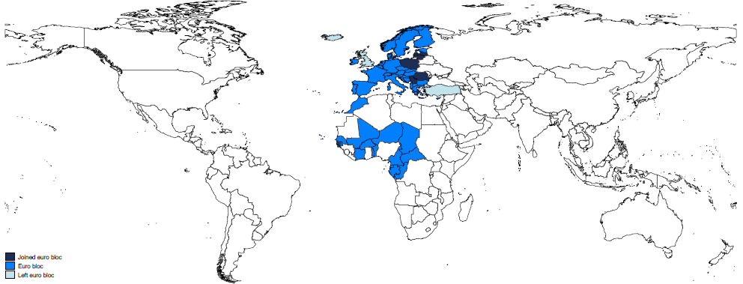
Countries with Euro Anchor

Slide 7
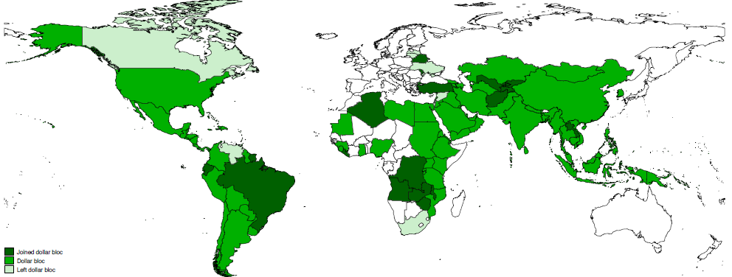
Countries with Dollar Anchor

Slide 8
Currency Composition of Central Bank Reserves: Dollar and Euro
Euro
Euro
Note: Allocated central bank reserves denominated in euro (bottom, blue) and dollar (top, green), 1995-2018.(Both left-hand axis.) The line (right-hand axis) shows total world central bank allocated reserves in billions of US dollars. The vertical line shows the date of euro adoption.

Slide 9
Foreign Exchange Turnover:
Shares of Major Currencies
Euro
Note: Share of foreign exchange transactions in which each of presented currencies was one side of the transaction, 1995-2016.

Slide 10
Borrowing in Euros and Dollars:
Developing Country Public Debt

Slide 11
Global Demand for Dollar and Euro Liquidity

Slide 12
Currency Home Bias in US and Eurozone Bank Holdings
Note: Share US banks’ gross foreign assets denominated in in dollars (top, green line) and of Eurozone banks gross foreign assets denominated in euro (post 1999) or ECU-lined currencies (pre 1999) (bottom, blue line).

Slide 13
Markers of an Anchor Currency

Slide 14
Why is the Euro Punching Below its Weight?

Slide 15
Why is the Euro a Far Second?
Possibility of natural monopoly in anchor currency.
  E.g. Hassan et al (2019), anchoring currency allows small countries to inherit anchor’s hedging qualities.
Shortage of € safe assets and fragmented EZ capital markets.
Lack of clarity on nature of Euro anchor.

Slide 16
Marketable Debt Outstanding, 2018
Note: The left panel shows the marketable central government outstanding in billions of US dollars in 2018 for France and Germany, all Eurozone countries (including France and Germany) and the US. The right-hand panel shows corporate bonds outstanding and total corporate bank lending as a percent of GDP in the Eurozone and the US.

Slide 17
Market Capitalization and Volume of Major Stock Exchanges

Slide 18
Foreign Holdings as a Share of Marketable Government Debt
Note: Percent share of marketable government that is held by foreign investors (private and official sectors). Source: Merler and Pisani-Ferry (2012).

Slide 19
Sovereign Spreads and Foreign Holdings as a Share of Marketable Gov. Debt
Italy
Spain
Portugal
Greece
Note: Percent share of marketable government that is held by foreign investors (private and official sectors, dashed lines, right-hand axis) and the spread of the 10 year bond of the country in question over Germany’s.

Slide 20
The ECB:
A Central Bank Finding its Footing

Slide 21
The Euro Anchor
Most of history: Anchor currencies achieved credibility by themselves being anchored to commodities
Since the end of Bretton Woods: backed by fiscal capacity and central banks managing their supply
EERM: bands around the DEM
  DEM backed with German fiscal capacity
ECB: de jure inflation targeting regime
  Backed by the fiscal capacity of…?
  But whose inflation is targeted?
We document two phases:
  “Bundesbank plus”: continuity with the EERM.
  “Whatever it takes”: expansive credit policies with potentially new uncertainties.

Slide 22
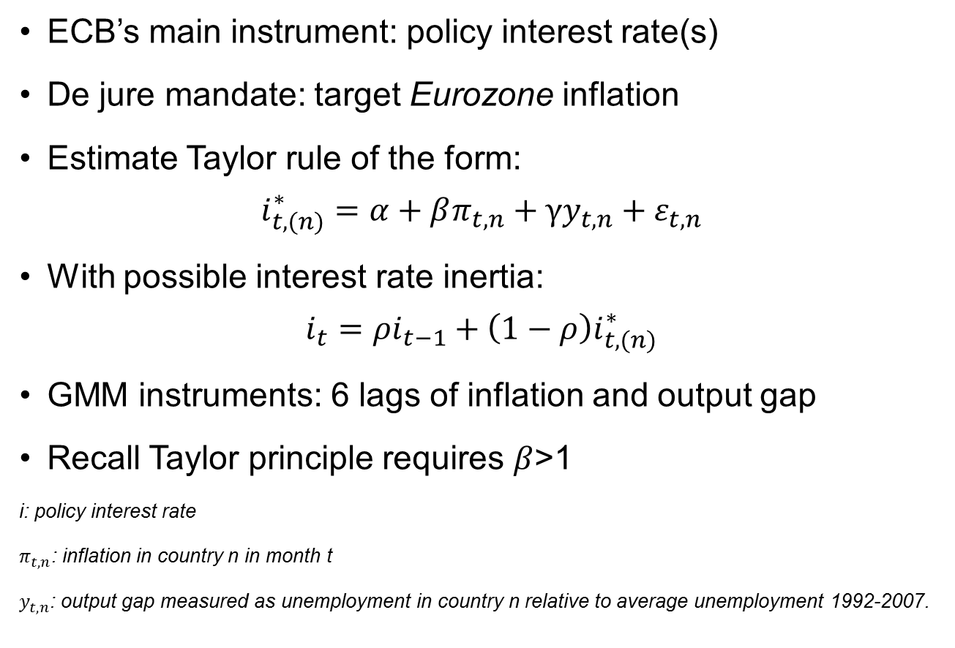
Taylor Rules for Eurozone Economies
ECB’s main instrument: policy interest rate(s)
De jure mandate: target Eurozone inflation
Estimate Taylor rule of the form:
$$i_{t,(n)}^{∗}=α+βπ_{t,n}+γy_{t,n}+ε_{t,n}$$
With possible interest rate inertia:
$$i_{t}=ρi_{t−1}+\left(1−ρ\right)i_{t,(n)}^{∗}$$
GMM instruments: 6 lags of inflation and output gap
Recall Taylor principle requires $β$>1
i: policy interest rate
$π_{t,n}$: inflation in country n in month t
$y_{t,n}$: output gap measured as unemployment in country n relative to average unemployment 1992-2007.

Slide 23
Inflation Coefficients

Slide 24
Output Gap Coefficients

Slide 25
Eurozone vs. German Inflation

Slide 26

Horse Race Regression
Test the hypothesis directly: can we reject that ECB is targeting German and not EZ inflation?
$$i_{t}^{∗}=i_{0}+β_{DE}\left(E_{t}π_{DE,t+1}−\overline{π}\right)+γ_{DE}E_{t}y_{n, t+1}$$
$$+β_{EU}\left(E_{t}π_{EU,t+1}−\overline{π}\right)+γ_{EU}E_{t}y_{EU, t+1}$$

Slide 27
Horse Race: Inflation Coefficients
Cannot reject: ECB follows German Taylor principle
Can reject: ECB follows EZ Taylor principle
Can reject: ECB puts greater weight on EZ than German inflation
Cannot reject: ECB puts zero weight on EZ inflation once controlling for German inflation

Slide 28
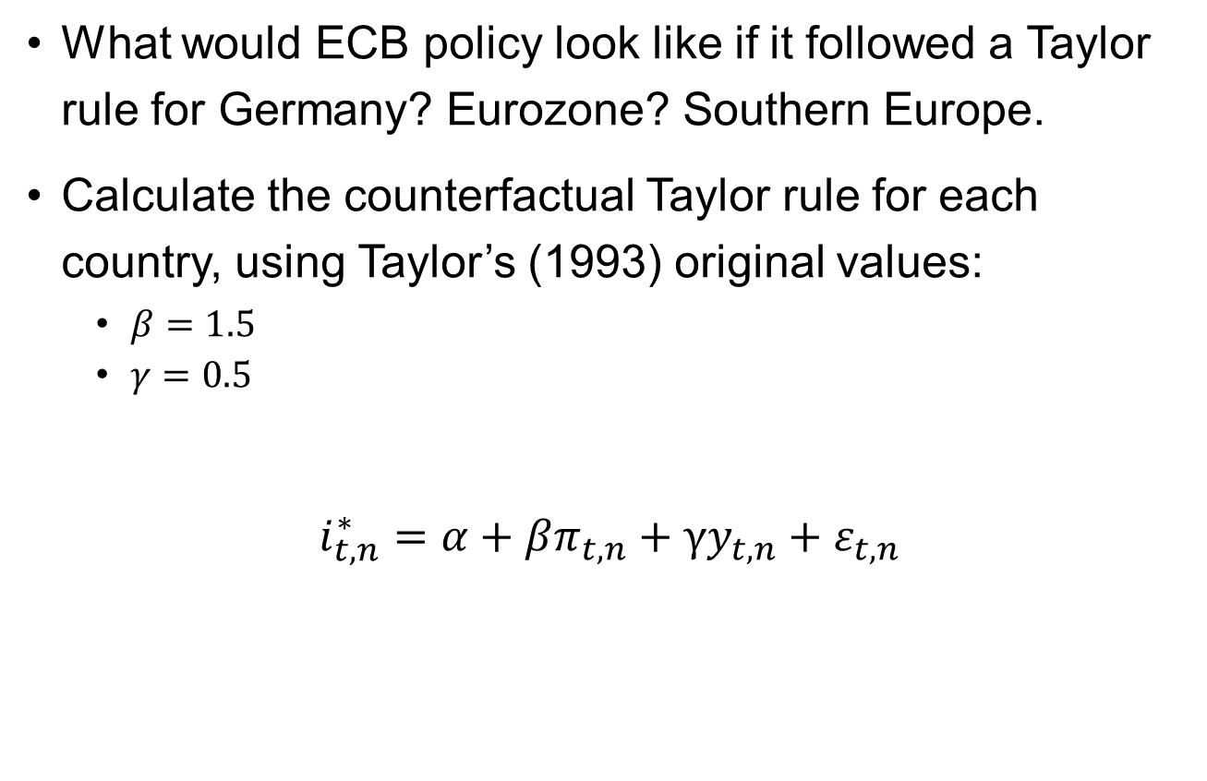
Counterfactual Taylor Rules
What would ECB policy look like if it followed a Taylor rule for Germany? Eurozone? Southern Europe.
Calculate the counterfactual Taylor rule for each country, using Taylor’s (1993) original values:
  $β=1.5$
  $γ=0.5$
$$i_{t, n}^{∗}=α+βπ_{t,n}+γy_{t,n}+ε_{t,n}$$

Slide 29
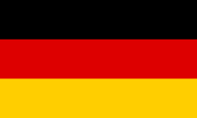
Taylor Rule vs. ECB Policy
Germany
DM
DM Regime
€ Regime
Rule
Policy

Slide 30
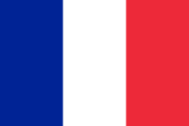
Taylor Rule vs. ECB Policy
France
DM
DM Regime
€ Regime
Rule
Policy

Slide 31
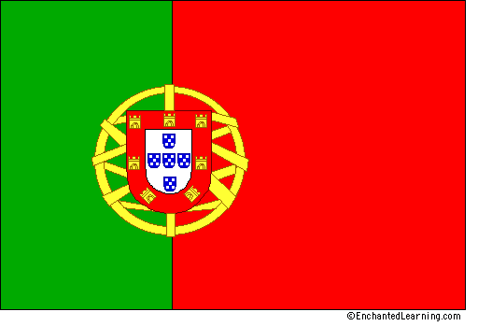
Taylor Rule vs. ECB Policy
Portugal
DM
DM Regime
€ Regime
Rule
Policy

Slide 32

Taylor Rule vs. ECB Policy
Eurozone
DM
DM Regime
€ Regime
Rule
Policy

Slide 33
MSE between ECB Policy and Taylor Rules

Slide 34
Summary
Euro is punching below its weight as international currency.
May be artefact of natural monopoly in international medium of exchange, store of value, unit of account
Scarcity euro safe assets and fragmented capital markets may be contributors
The nature of the euro anchor is a work in progress
China is the main wildcard: China/RMB role in international monetary system will be central, incl. in Euro’s relative role

